Slide 1
August 2025
Johann Resl
Honeywell Tissue solutions
Experion MX

Slide 2

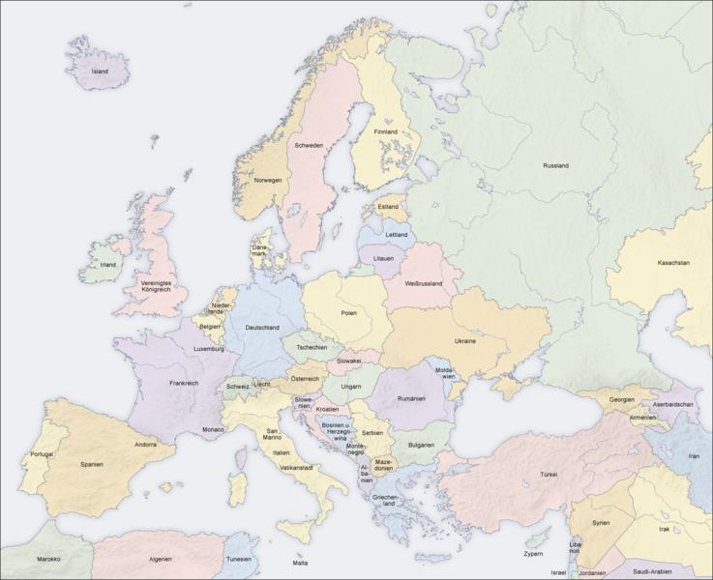




















Honeywell in Pulp & Paper Industry
  First DCS TDC2000 for pulp & paper mill automation since the early 1980s
  Acquisition in 1994 of Ahlstrom Automation - formerly owned by Ahlstrom Machinery, which subsequently became Andritz
  Acquisition in 1997 of Measurex Inc, #1 supplier of QCS and CD control systems
  The synergies between the industry specialists in Europe, Asia and in North America provide unique solutions benefits for the Honeywell customers globally
  Honeywell global project team has implemented over 500,000 process control points in more than 30 greenfield pulp-paper mill projects in last 10 years
Established local customer oriented organization with global support
Notes:
Pioneer of DCS – TDC2000
P2: Ahlstrom -> Andritz
Global capability -> complete solution provider
Strong track record of succes

Slide 3
TISSUE QCS References past 5 years
19301 | 30-Jul-21 | 10-Dec-21 | PT OKI Pulp and Paper Mills | Sumatera Selatan |  | Indonesia | TM 7 | Asia-Pacific | Tissue and Towel
19302 | 30-Jul-21 | 10-Dec-21 | PT OKI Pulp and Paper Mills | Sumatera Selatan |  | Indonesia | TM 8 | Asia-Pacific | Tissue and Towel
19303 | 30-Jul-21 | 10-Dec-21 | PT OKI Pulp and Paper Mills | Sumatera Selatan |  | Indonesia | TM 9 | Asia-Pacific | Tissue and Towel
19304 | 30-Jul-21 | 10-Dec-21 | PT OKI Pulp and Paper Mills | Sumatera Selatan |  | Indonesia | TM 10 | Asia-Pacific | Tissue and Towel
19405 | 14-Sep-21 | 01-Feb-22 | Eczacibasi Tuketim Urunleri | Yalova |  | Turkey | TM 3 | EMEA | Tissue and Towel
19407 | 26-Nov-21 | 29-Apr-22 | MG TEC INDUSTRY S.R.L. | DEJ |  | Romania | TM 2 | EMEA | Tissue and Towel
19403 | 14-Dec-21 | 15-Apr-22 | A Celli Paper SpA | Lucca |  | Italy | TM 1 | EMEA | Tissue and Towel
19411 | 30-Dec-21 | 07-Jun-22 | Von Drehle Corp | Cordova | North Carolina | United States | TM 1 | Americas | Tissue and Towel
19412 | 30-Dec-21 | 07-Jun-22 | Von Drehle Corp | Cordova | North Carolina | United States | TM 2 | Americas | Tissue and Towel
19180 | 11-Apr-22 | 26-Aug-22 | Andritz (Asia Symbol) | Jiangmen |  | China | TM 1 | Asia-Pacific | Tissue and Towel
10098 | 28-Apr-22 | 07-Oct-22 | ST Paper LLC | Oconto Falls | Wisconsin | United States | TM 2 | Americas | Tissue and Towel
15447 | 27-May-22 | 06-Jan-23 | Fabrica De Papel San Francisco | Mexicali |  | Mexico | TM 4 | Americas | Tissue and Towel
15448 | 27-May-22 | 06-Jan-23 | Fabrica De Papel San Francisco | Mexicali |  | Mexico | TM 5 | Americas | Tissue and Towel
19651 | 29-Jun-22 | 23-Dec-22 | Andritz (Asia Symbol) | Rizhao | Shandong | China | TM 33 | Asia-Pacific | Tissue and Towel
19652 | 29-Jun-22 | 23-Dec-22 | Andritz (Asia Symbol) | Rizhao | Shandong | China | TM 34 | Asia-Pacific | Tissue and Towel
15453 | 19-Sep-22 | 27-Oct-23 | Fabrica de Papel San Francisco | Mexicali |  | Mexico | PM 9 | Americas | Tissue and Towel
19449 | 22-Nov-22 | 29-Sep-23 | Andritz (Bracell) | Lençóis Paulista | Sao Paulo | Brazil | TM 1 | Americas | Tissue and Towel
19450 | 22-Nov-22 | 29-Sep-23 | Andritz (Bracell) | Lençóis Paulista | Sao Paulo | Brazil | TM 2 | Americas | Tissue and Towel
19451 | 22-Nov-22 | 29-Sep-23 | Andritz (Bracell) | Lençóis Paulista | Sao Paulo | Brazil | TM 3 | Americas | Tissue and Towel
19452 | 22-Nov-22 | 29-Sep-23 | Andritz (Bracell) | Lençóis Paulista | Sao Paulo | Brazil | TM 4 | Americas | Tissue and Towel
19484 | 25-May-23 | 01-Dec-23 | Fourstones Paper Mill | Leslie |  | United Kingdom | TM 6 | EMEA | Tissue and Towel
10031 | 12-Oct-23 | 25-May-24 | BiOrigin Specialty Products | East Hartford | Connecticut | United States | TM 2 | Americas | Tissue and Towel
20101 | 20-Oct-23 | 15-Jan-24 | Glucholaskie Zaklady Papiernicza Sp zoo | Glucholazy |  | Poland | TM 2 | EMEA | Tissue and Towel
19913 | 01-Dec-23 | 17-Jun-24 | Andritz China Ltd (Longjing Paper ) | Chongqing |  | China | TM 1 | Asia-Pacific | Tissue and Towel
20116 | 08-Dec-23 | 20-Jun-24 | A.Celli Paper SpA |  |  | Mexico | TM 2 | Americas | Tissue and Towel
15457 | 22-Dec-23 | 07-Dec-24 | Fabrica de Papel San Francisco | Mexicali |  | Mexico | TM 10 | Americas | Tissue and Towel
20123 | 28-Dec-23 | 08-Jul-24 | Twin Rivers Paper Co LLC | Little Falls |  | United States | PM3 | Americas | Tissue and Towel
20128 | 23-Feb-24 | 01-Jul-24 | Lewandowski | Wloclawek |  | Poland | TM 6 | EMEA | Tissue and Towel
20132 | 11-Mar-24 | 30-Aug-24 | MPI Paper Mills of Portneuf | Portneuf | Quebec | Canada | PM 4 | Americas | Tissue and Towel
14702 | 28-Mar-24 | 24-Oct-24 | Essity Chile SA | Lampa | Santiago | Chile | TM 3 | Americas | Tissue and Towel
20146 | 29-Mar-24 | 15-Nov-24 | Hanke Tissue | Kostrzyn nad Odra |  | Poland | TM 4 | EMEA | Tissue and Towel
10022 | 21-Jun-24 | 18-Mar-25 | Procter and Gamble | Mehoopany |  | United States | TM 6M | Americas | Tissue and Towel
12862 | 23-Sep-24 | 27-Mar-25 | Calcarta SRL | Chifenti-Fornoli | Lucca | Italy | TM 2 | EMEA | Tissue and Towel
20172 | 21-Feb-25 | 15-Aug-25 | PT.Graha Bumi Hijau | Karawang |  | Indonesia | TM 1 | Asia-Pacific | Tissue and Towel
Notes:
In a typical year we will deliver 10-15 tissue machine QCS projects per year, all over the world
top global producers as well as local & national producers
We are not dependent on any machinery company but we have good project track record with Andritz

Slide 4

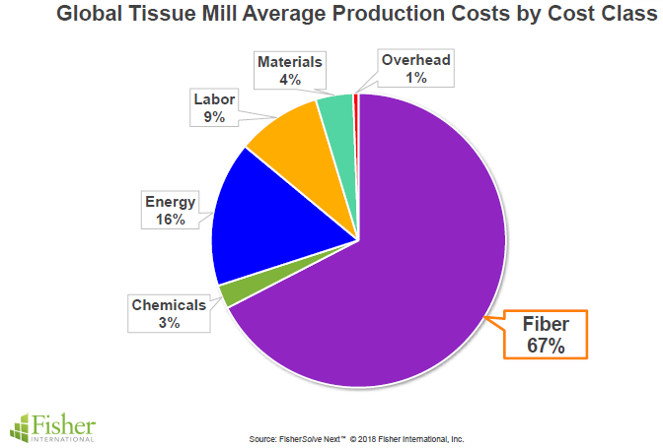

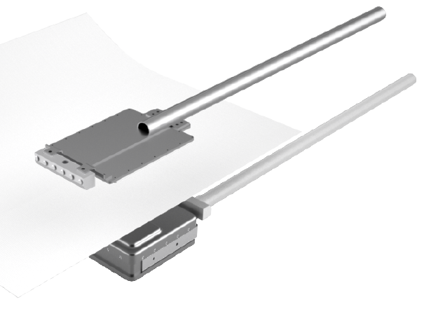
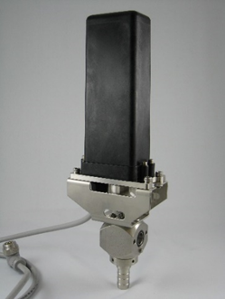

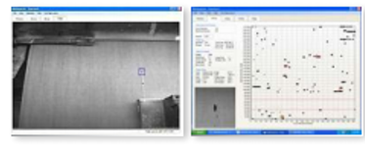

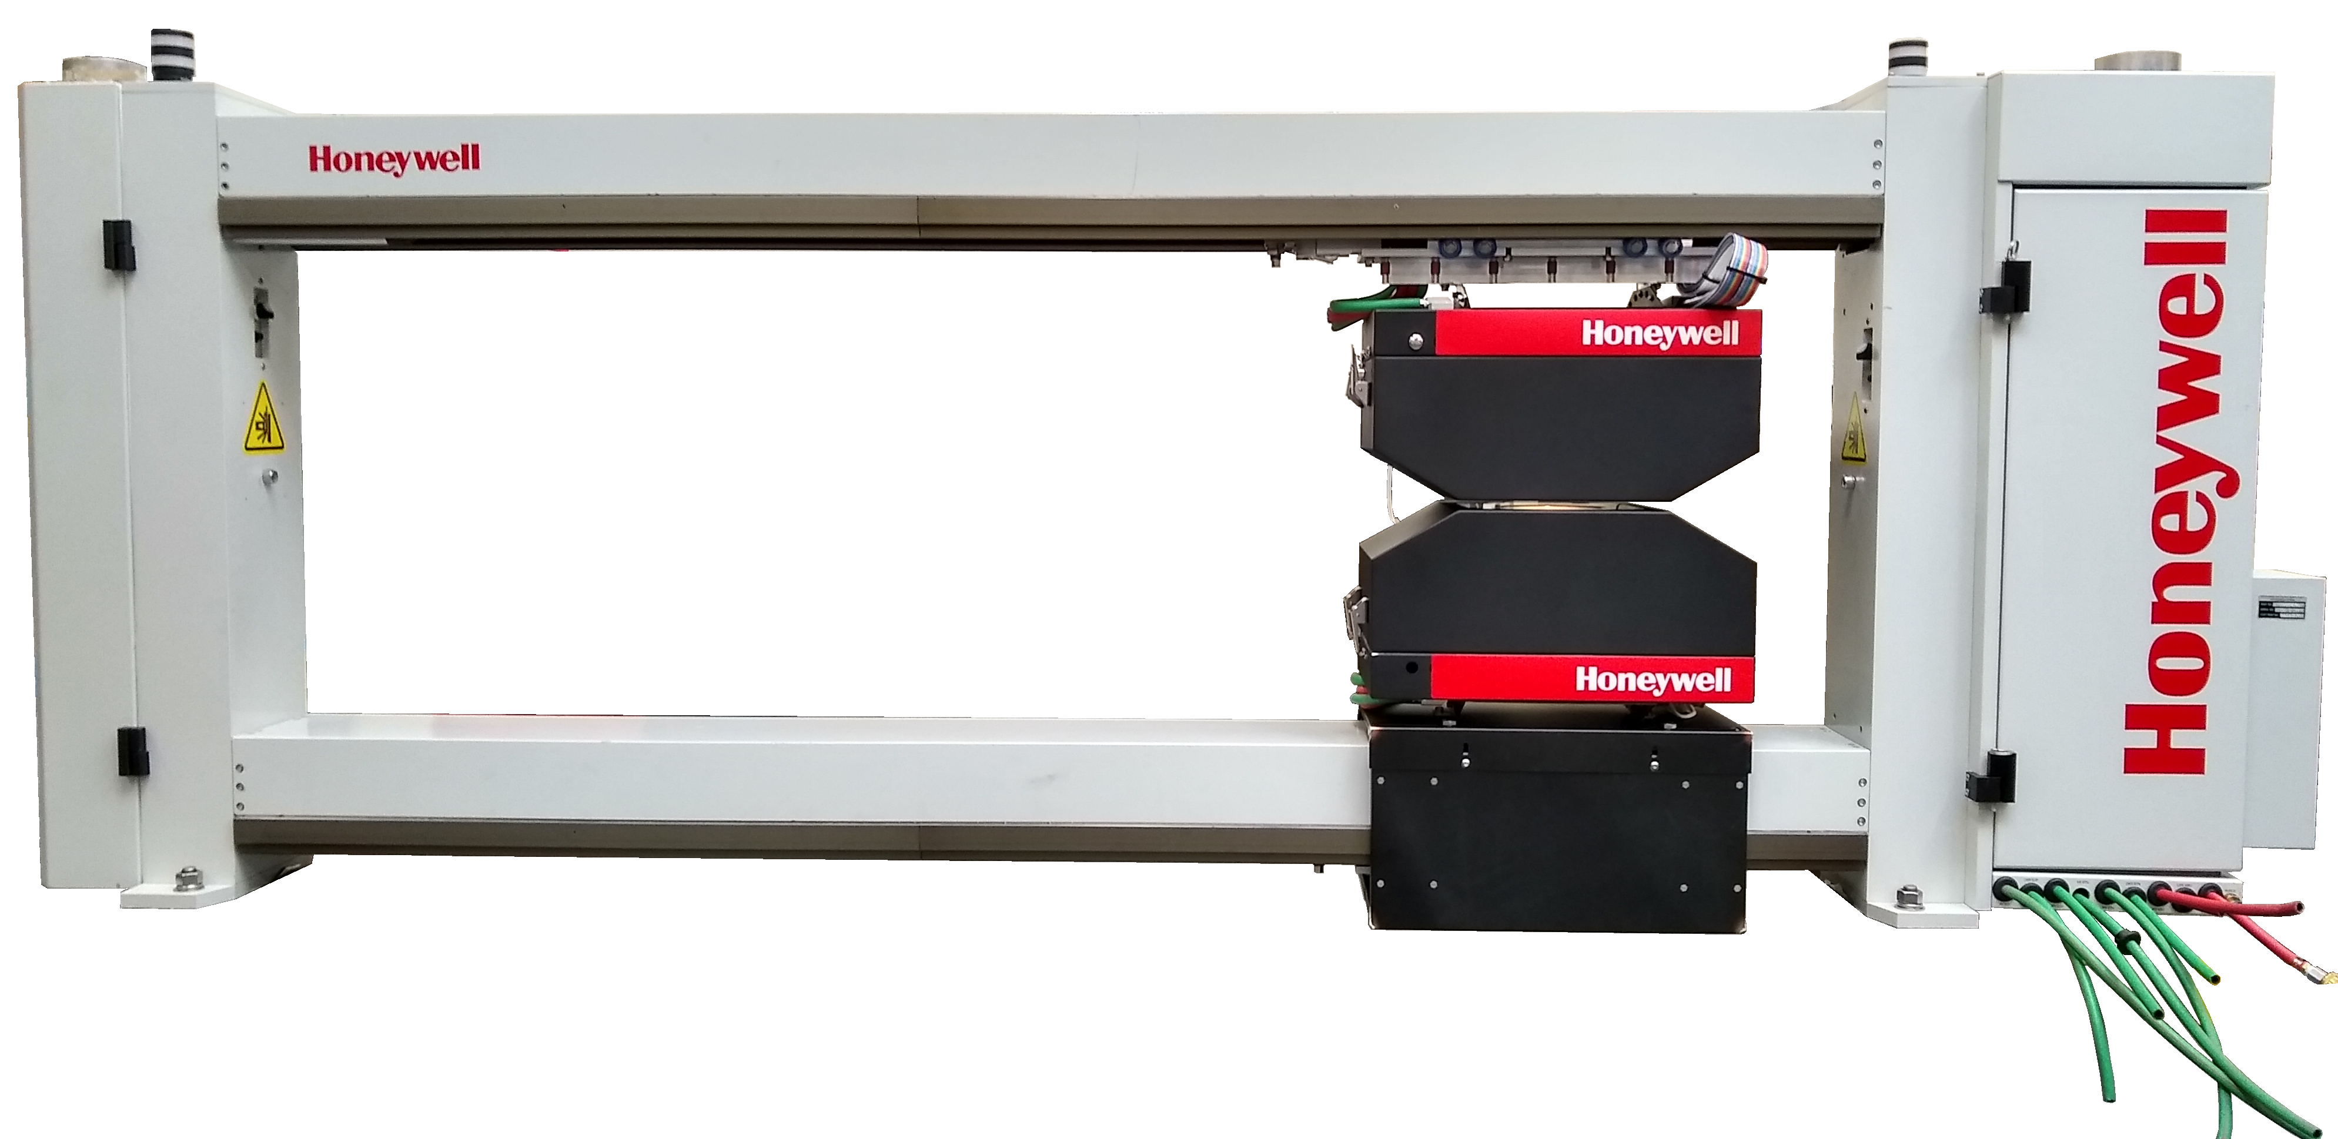
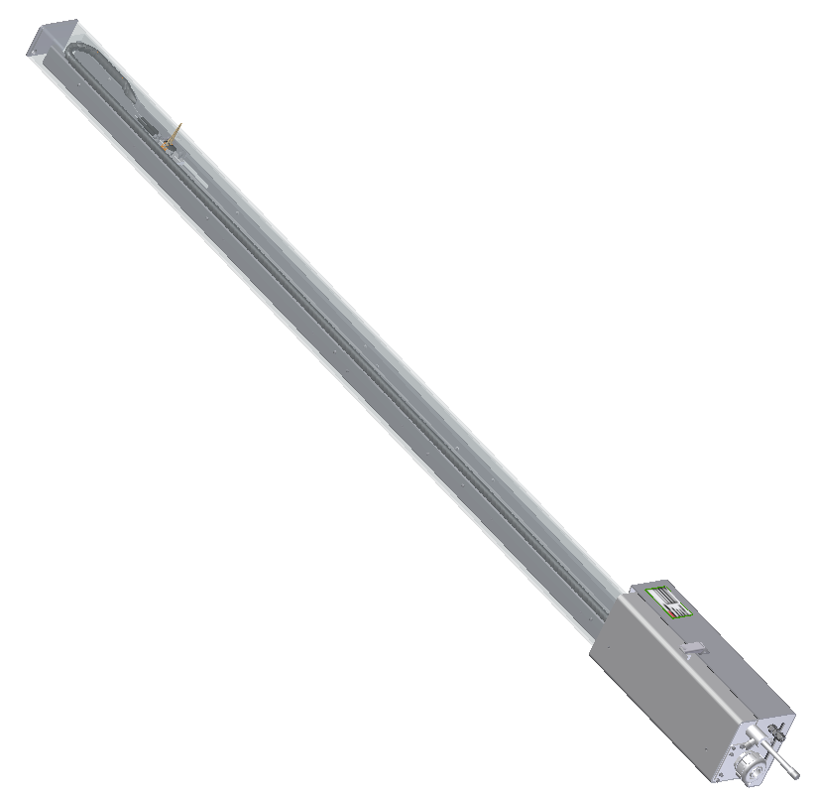

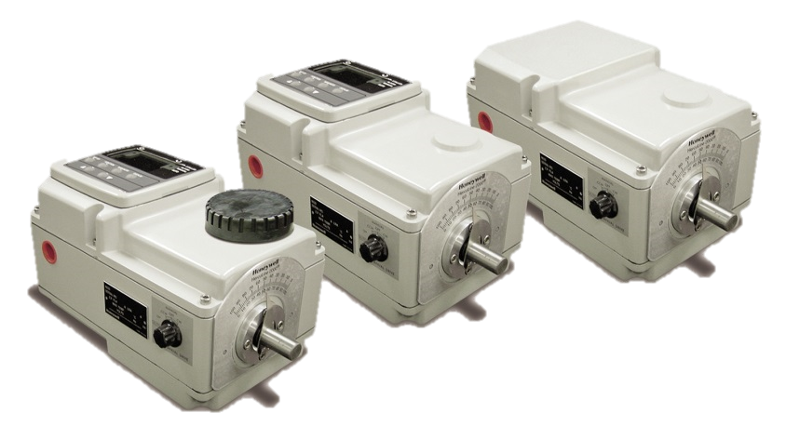
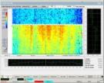
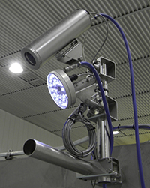
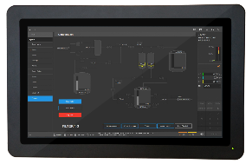
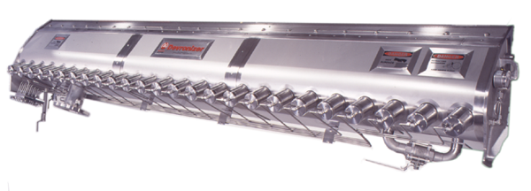
Experion MX : All-in-One Integrated Solution for Tissue
86% is fiber,
energy, & chemicals
Multivariable Controls:
- MD & CD Weight Control
- MD & CD Moisture Control
- Coordinated Yankee / Hood Energy Control
- Grade Change Control
-Single Point
Moisture measurement
Web Inspection
MegaFire Yankee Hood
Burners
Process & Safety Control with Control Edge™
Weight
CD Control
Reel Scanner:
Q6088 Scanner
Sensors:
IR weight / moisture Sensor
Kr85 & Pm147 (recycle)
Crepe
QCS
EPKS full integration
Control Builder & Consoles
  FTE / DSA / CEE
SIL2 & SOE
ISASecure L2
Ethernet/IP
OPC UA/
Modbus TCP
ProfiNet
Universal I/O
Ring I/O network
Express CD scanner
- Moisture measurement
Crepe Quality On-line
Hood Damper
CD Moisture Control
Moisture CD Control
Crepe profile control
Magibox steam generator
Web Defect Monitoring
- 2 or sets of high-speed camera
Notes:
We have very successful tissue business with our partners such as Andritz & other key customers around the world. Crepe measurement is unique capability of HON. All critical quality information can be integrated into our ExperionMX. Devronizer is perfect for tissue, basically guarantees 10% machine speed up, even in manual mode with no profile control. Integration with WIS brings in the visual defect information, for example to Quality Optimizer, for total view of sheet quality.

Slide 5
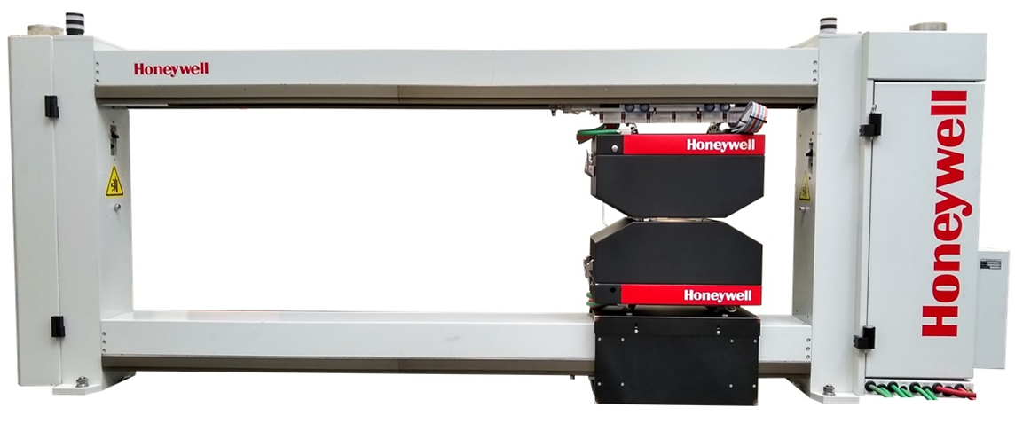
Q6088 Tissue Scanner Overview
Description | Value
Maximum Beam Width | 320.00 inches [8000mm]
Maximum Sheet Width (Comply with EN349) | 256 inches [6400mm]
Minimum Scan Speed | 50 mm/s [2 in/s]
Maximum Scan Speed | Up to 355 mm/s [13.97 in/s]
Minimum Ambient Temperature | 10 ⁰C [50 ⁰F]
Maximum Ambient Temperature | 65 ⁰C [140 ⁰F]
Web temperature (⁰C) | 80 ⁰C [176 ⁰F]
Sensor Gap | 10.2 mm [0.4 in]
Dusty Environment Protection | Purging and sealing of end bells and beams Sealed heads Head gap air purge
Power | 115/230 VAC, 50/60 Hz
Scanner Weight | 173 LB + 2LB/IN [91 KG] + [0.4 KG/CM]
Certifications | CSA / UL / CE
All new scanner frame with tissue environment protection
Sensors and signal processing with EDAQ technology
Improved serviceability with all electronics in one end
Non-nuclear basis weight and moisture
Online crepe & tissue caliper sensor

Slide 6
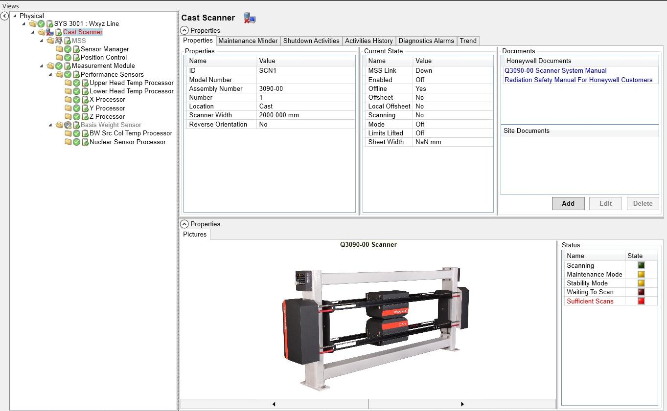
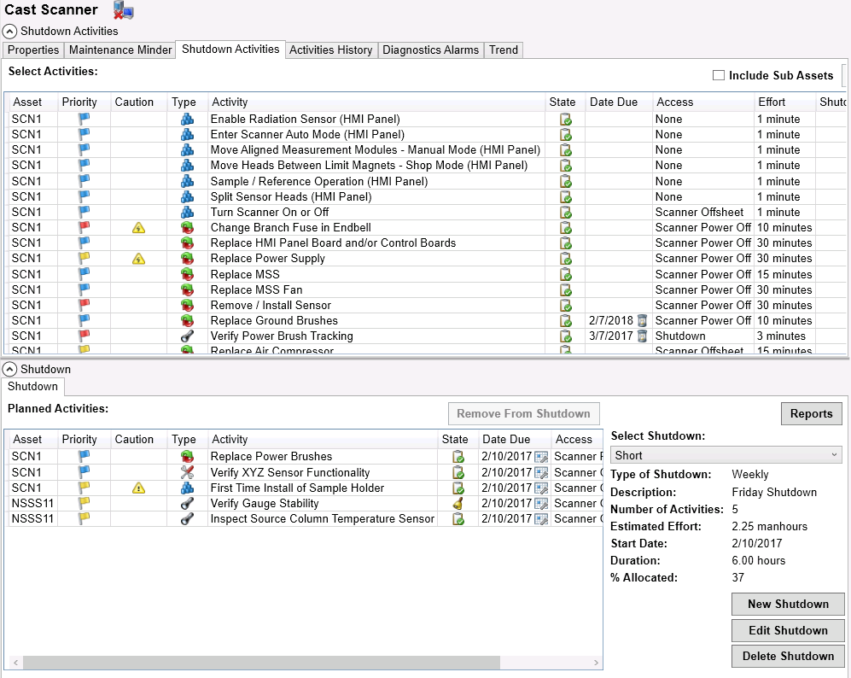
Q6088 : IIoT Scanner based on EDAQ Technology
EDAQ = truly intelligent scanner
All scanner & sensor measurements and diagnostics available online anywhere 24x7
Built in smart fault-models and alerting system
Built in PM maintenance routines
QCS4.0 ready ‘out of the box’
Notes:
Reduce lifecycle cost of ownership through EDAQ and QCS4.0 -> very powerful combination

Slide 7
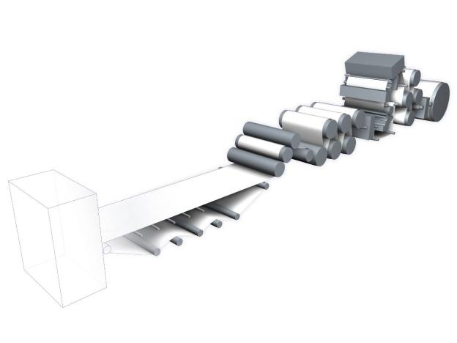
ExPress Moisture For Pre-Yankee Moisture Measurement
ExPress Moisture
  Fiber optic sensors
    Single sided infrared moisture measurement
    All electronics off-sheet
    Very small & lightweight sensor head
    5 mm spatial resolution @ 4 m/sec
  CD & MD elements
    Small robust & fast CD scanner
    Small robust MD fixed point sensors
  Scalable architecture
    Any number of CD or MD measurements possible
      Typically 1 scanner plus 2 to 4 fixed point measurements
    Plugs into QCS network with Ethernet cable
    OPC or other protocols to competitive or legacy QCS/DCS
CD Scanner
MD Fixed Point
Notes:
Express Moisture key features: gives moisture content & profile before Yankee cylinder; this cannot be seen by the reel scanner but as machine speeds increase and wear & tear on felts the wet end operation is critical for runnability/OEE

Slide 8
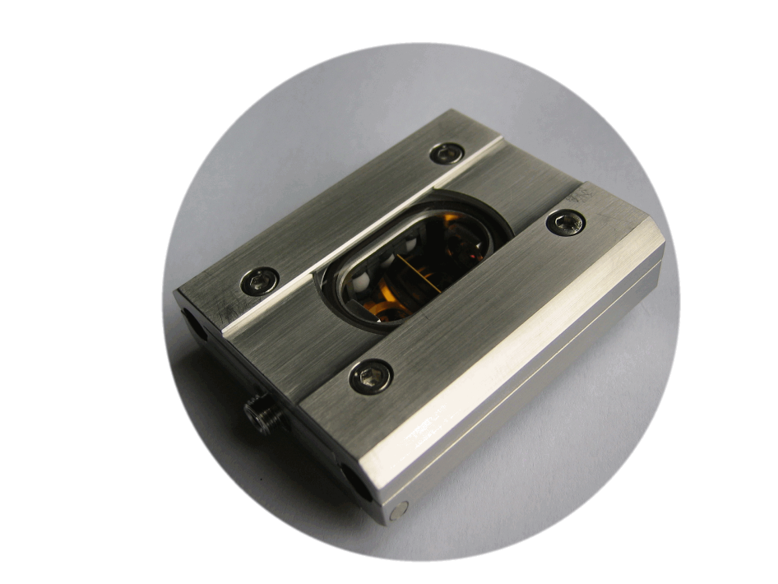
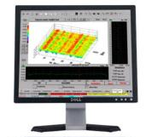
ExPress Moisture Architecture
SLED
1300
Driver & TEC
SLED
1450
Driver & TEC
Lock-in Amp
Frequency 1
Pre-amp
Lock-in Amp
Frequency 2
Off-machine Electronics Enclosure
Sensor Head & Scanner – No Electronics
Measures %H₂O via selective IR absorption
Optical fibers used to deliver and collect light
  Measure & reference wavelengths collected by 1 optical fiber
  Single detector measures all wavelengths simultaneously
Notes:
ExPress Moisture sensors are relatively simple. IR rich light is coupled into a fiber optic cable in the Sensor Support Cabinet, off-machine, usually on the back side of the machine. The fiber optic cable then delivers the light to the sensor head where it is redirected to the sheet. The light then interacts with the sheet and its moisture content, absorbing some wavelengths more than others. Some of the light is then emitted from the sheet and collected by the sensor head, which couples that light into a fiber optic cable and delivers it back to the SCC where the light is detected and analyzed. The measurement works on the same principle as all other IR moisture sensors, based upon selective absorption of IR radiation.
For the technically minded, two laser diode controllers are used to control both the temperature and drive current to the SLEDs (IR sources). An SLED with centre wavelength and full width half maximum line-width specification of 1310±20 nm and >45 nm respectively is used as the reference source and an SLED with centre wavelength and full width half maximum line-width of 1450±10 nm and >40 nm respectively is used as the measure source. These wavelengths were chosen because high power SLED sources are available at these wavelengths and there is a water absorption peak around 1450 nm.

Slide 9
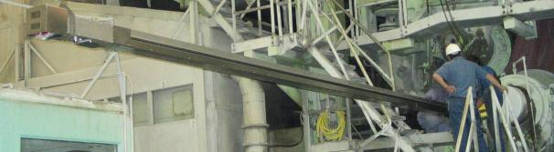
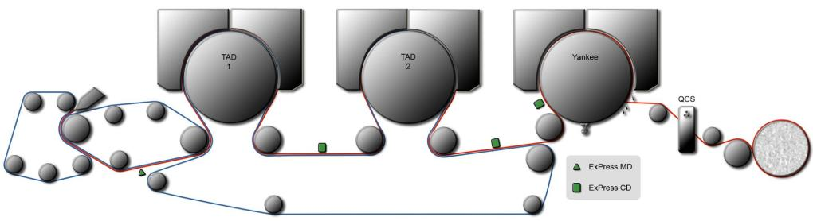
Integrated Quality Control Solution for the Whole Machine
Moisture Control before Yankee
  MD
    TAD Hoods
  CD
    Steam Boxes
Optimization
  Clothing
  Crepe blades
  Release agent

Slide 10
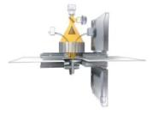
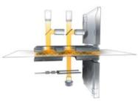
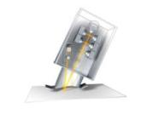
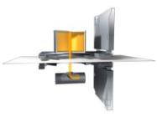
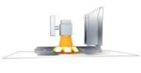
QCS New Measurements: Extensive & Growing portfolio
Basis weight
  Infra-Red (Tissue)
  Isotope choices: ¹⁴⁷Pm ⁸⁵Kr ⁹⁰Sr
  Ash insensitivity choices
Moisture
  Infrared
    Single Sided
    Transmission
  Microwave
  ExPress Moisture (MD & CD)
Caliper
  Contacting
  Non-contacting Optical
Ash
  Mixture insensitivity choices
Porosity
Color
Gloss
Opacity
Crepe
Surface Topography
  Smoothness
  Roughness
Formation
Fiber Orientation, Anisotropy
Strength (ESS)
Coat Weight
Multi-layers/Polymers (RIS)
Sheet Temperature
X, Y & Z
Honeywell has introduced more on-line sensors in the last decade than all of the competition combined

Slide 11
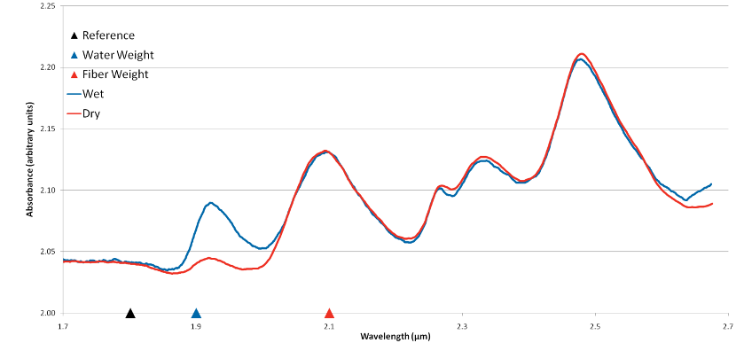








Infrared Moisture & Fibre Weight Measurement
Advantages of IR
Less sensitive to
  Head alignment
    X, Y & Z
  Air gap temperature
    Compensation measurements are not always robust
  Window dirt
No radioactive source decay
No worker safety and nuclear regulatory requirements
Single sensor, easier maintenance, less spare parts
  Moisture & Fiber Weight
Measurement & Diagnostic Processor
Water Detector
Beam Splitter
Fiber Detector
Scatter Channel
Dif/Ref Surface
Diffusing Reflective Surface
Light Chopper
Measurement & Diagnostic Processor
Ethernet
Notes:
This diagram shows schematically how the sensor works. The INFRAND plates are shown as the white surfaces on either side of the gap labeled as Diffusing Reflective Surfaces. This is a smart sensor that digitizes and timestamps its signals so that they can be communicated over Ethernet.

Slide 12
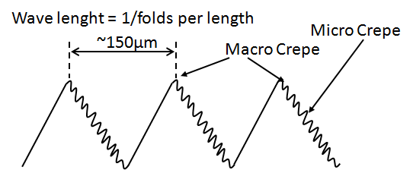
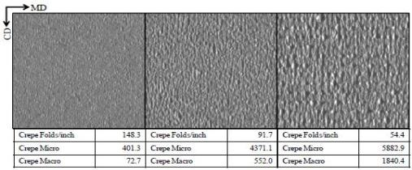


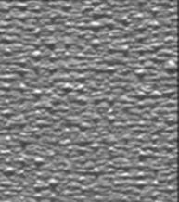
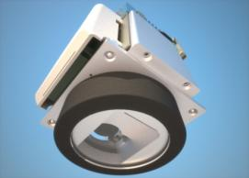
Introduction to Crepe Structure Measurement
Measured Variables:
  Crepe Folds per length unit (centimeter or inch)
  Crepe Micro
  Crepe Macro
  Crepe Impurity
  Caliper*
  Stretch* (MD scan average only)
Images are captured at 10Hz rate and numeric values are reported as profile and scan average
In addition, the operator can observe images from up to 4 freely selectable CD positions during each scan
Passline and grayscale measured as auxiliary and diagnostic measurement
Notes:
Crepe Structure Measurement provides numerical characterization for following variables
[X] Folds per Lenght (cm or inch)
Crepe Micro = image grey scale variance within given wavelength band (short)
Crepe Macro = image grey scale variance within given wavelength band (long)
Crepe Impurity = positive, if light pixels dominate; negative, if dark pixels dominate.
[X]
Caliper and Streach are not primary, but additional measurements and are highly dependend on application and grade

Slide 13
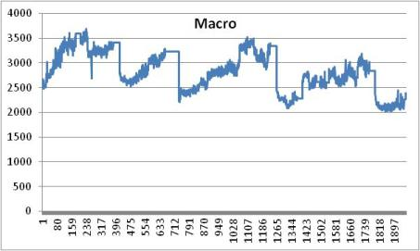
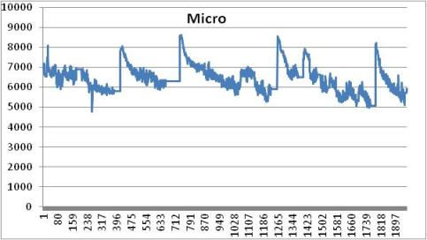
Crepe Micro/Macro – Blade Change Impact
Crepe Macro increases as the blade wears
  ”Energy” (=amplitude and/or frequency) of crepe waves increase
Rapid initial decay in micro crepe during blade settling
Crepe micro decreases as the blade wears
  Surface softness and silkyness decreases
= blade change
= blade change
Crepe coarsiness increases as a blade wears

Slide 14
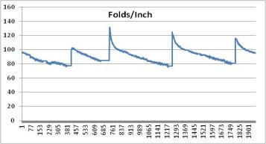
Crepe Folds per Inch – Blade Change Impact
Rapid initial decay in measurement during first 5-15min due to blade settling followed by more linear decay similar to crepe micro
As the blade wears
  Wave length of creping increases
  Bulkiness and surface area decreases
= blade change
Folds/length shows good repeatability

Slide 15
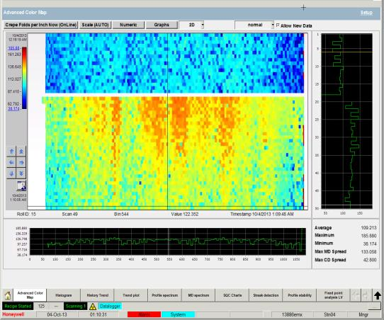
Blade Change in Folds/length Color Map
Colormap shows 50 consecutive scans before and after a blade change
Blade change identified by dashed line
Blade wearing has a major impact on crepe CD performance
Uneven crepe profile causes
  Runnability problems in converting process
  Lag in MD target (reduced efficiency)
  Uneven Yankee wearing
Automatically notifiy operator when crepe deviation is greater than limit
Notes:
Waterfall graphics in this slide shows 50 consecutive crepe folds per inch cross direction profile measurements before and after the blade change as where the most recent measurement is on the top.
Graphics clearly shows significant step right after the blade change. In addition to obvious jump in profile average, the shape of the profile also changes significantly.
As the blade reaches its end of life, profile gets more deviated from its flat optimum as can be seen in the graphics at the middle of the sheet.
Like with any other online measurement, it is possible to set specific profile deviation limits within the QCS system to notify operator if any of the crepe structure variables deviates more than accepted.
Profile measurement applies a tool for process target shifts or optimization. In addition, crepe profile data carries valuable information about condition of the process and helps user to evaluate possible needs for adjustments and maintenance actions to maintain quality within an acceptable range. Uniform quality of a jumbo roll crepe in cross direction ensures good efficiency and runnability in post converting process.

Slide 16
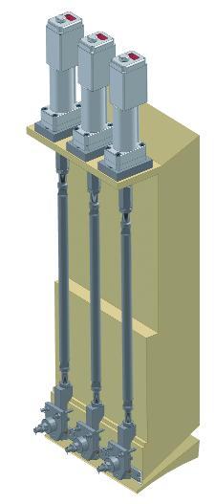
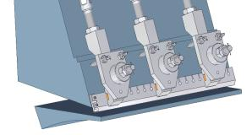
BW- CD Control Maximum Performance
Intelligent actuators 4.4KN, 15.5 KN & 45 KN torque models
CD stepper motor with steel harmonic gear
Internal AC-powered LVDT
Displacement limiter
Optional digital display
Super Flex Slice Lip
  2 - 5 times conventional slice lips
  T316 or titanium
Web Manager & Web Explorer
AutoSlice CDW
Actuator
Coupling
Spindle Rod
Reduce 2-sigma weight variation
  50 - 90% compared to manual
  25 - 75% compared to other automated controls
Reduce sheet break and startup recovery times by 25 - 50%
Reduce grade change times by 25 - 50%
1 - 2% fiber savings from target shift, or
1 - 2% production increase from target shift
Apron
Super Flex
Slice Lip

Slide 17
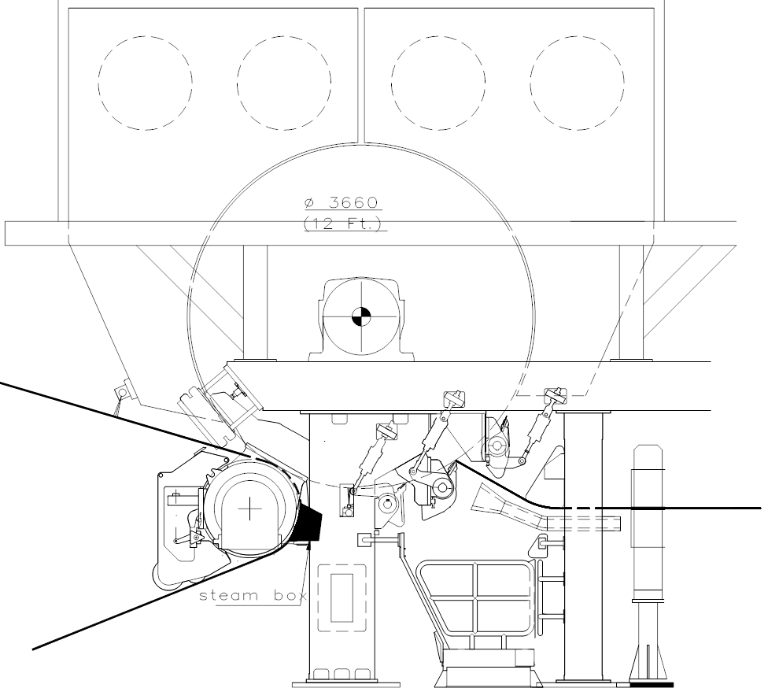

Devronizer CD Moisture control for TM
Location: Encore Paper, USA
9% increase in speed, from 939 - 1024 m/min
Simultaneously, average moisture increased by 0.7%, from 4.5 - 5.2%
CD moisture profile variation decreased by 23%
Moisture streaks totally eliminated
10 year actuator guarantee

Slide 18

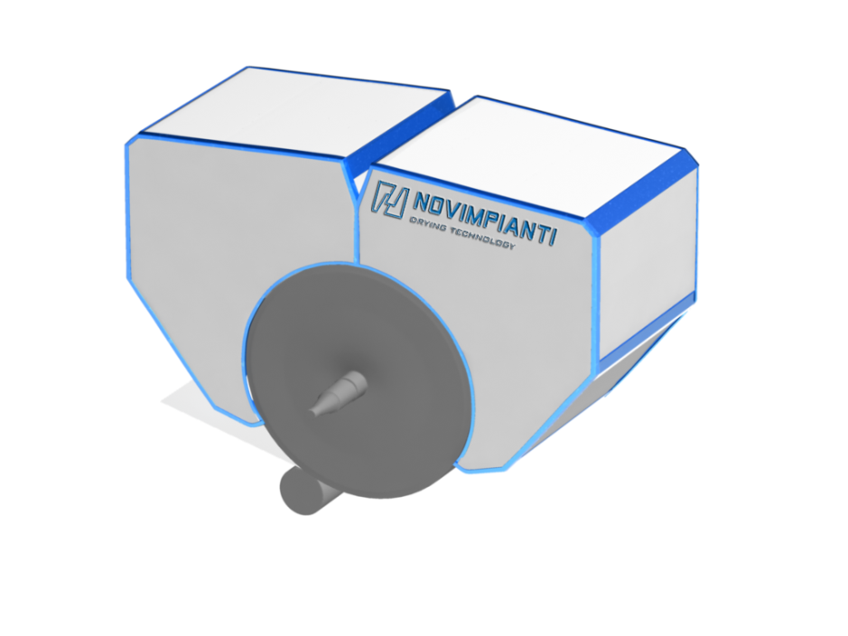


Novimpianti/Honeywell magixbox
BURNER
MAIN FAN
The new proven tissue MagiX Box concept is based on:
using of waste heat from drying process of tissue machines to produce low pressure steam through a Steam Generator system
feeding with this low pressure steam a new generation Steam Box on tissue machine suction roll. The result is an improvement of tissue dryness after press and consequently a production extra capacity at zero additional energy cost
HT
HOOD
Devronizer
STEAM GENERATOR
«MagiX Box»
EXHAUST
FAN

Slide 19
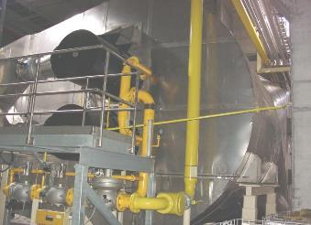
High Efficiency Burners: MAXON – A Honeywell Company
Yankee Hoods
MEGAFIRE® burner
Nominal capacity : up to 13200 kW
Turndown : 15:1
Fuels : natural gas / propane / biogas /
butane / light oil / kerosene
Key feature : high capacity gas / oil burner
High efficiency heating of process air with very high water-content, works with changing backpressures and preheated combustion air

Slide 20
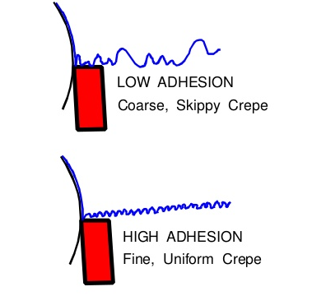
Sheet dryness Increase = Speed increase & Lower CD Crepe Variability
The dryness inlet increase of each 1% could be seen as:
    machine speed increase of 5% with same dryer load or…
    reduction of the drying capacity evaporation need (typically by the Yankee Hood) of about 5%
Devronizer CD Moisture control brings greatly reduced moisture variability, which has many benefits for creping process
    Uniform adhesion & protects the Yankee surface from the blades
    Increased sheet bulk & sheet softness
    Increased absorbency & stretch
+ 9%
Confidential Customer Machine Information:
Application Yankee press
Grade Napkin
Sheet Width 3581 mm
Machine TM # 3
Speed without MagiX Box 940 m/min
Speed with MagiX Box 1024 m/min
1040
VARIABLE ADHESION DUE TO MOISTURE ISSUES (Before)
Coarse, Skippy Crepe
Higher wear on the Yankee surface
1020
1000
980
960
940
920
900
880
860
ADHESION DUE TO FLAT MOISTURE PROFILE (After)
Fine, uniform crepe
Longer time between Yankee re-grinds
840
820
800
Before MagiX Box
After MagiX Box

Slide 21
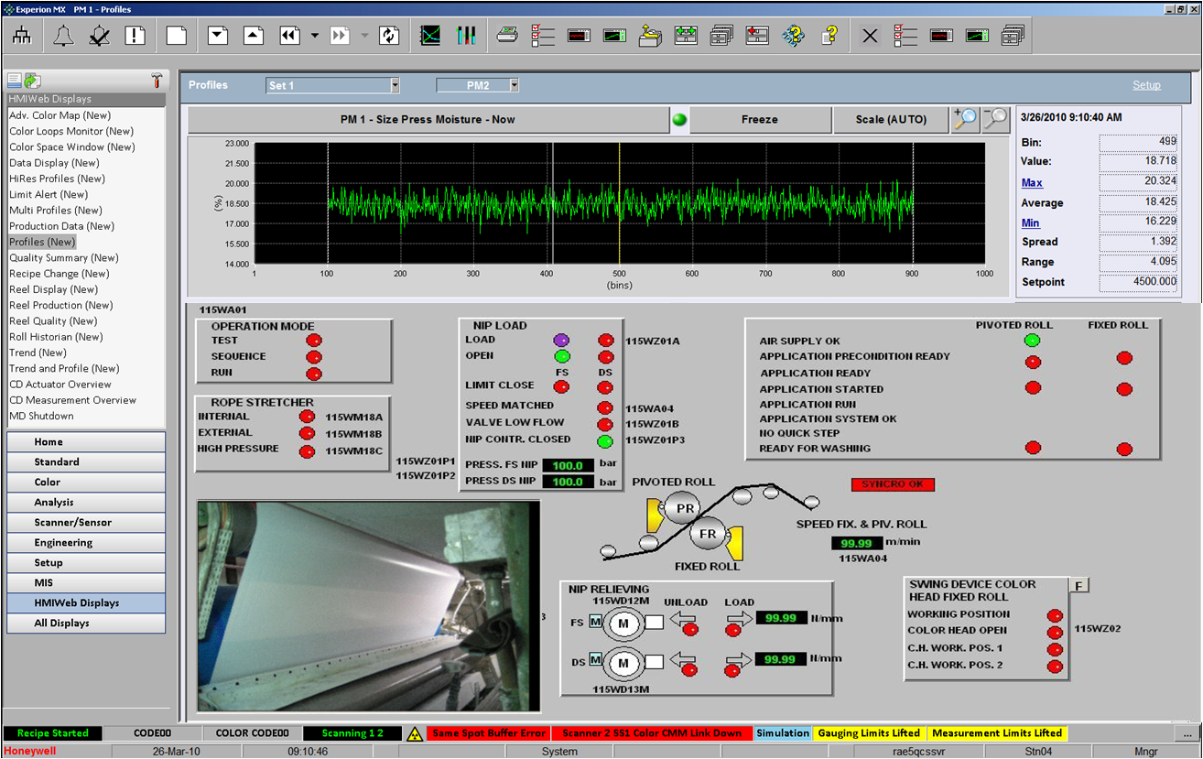





EXPERION MX PLATFORM: INTEGRATED OPERATIONS
Experion MX supports full interoperability since R410 and later versions of Experion PKS control platform
Integrated HMI
Integrated Alarms and Events
Integrated Trends
Common Virtualization Production Hosts
Distributed Server Architecture (DSA) allows integration with multiple Experion PKS versions (n-3 to n+3)
Native C300 & ControlEdgge peer to peer communication
Experion PKS Servers
Orion, Console or Flex Stations
FTE Process Control Network
C300
Thin Client User Interface
Experion MX Server
Notes:
Seamless integration into the overall l PKS topology => some of our competitors still claim today that our QCS is standalone and not integrated

Slide 22
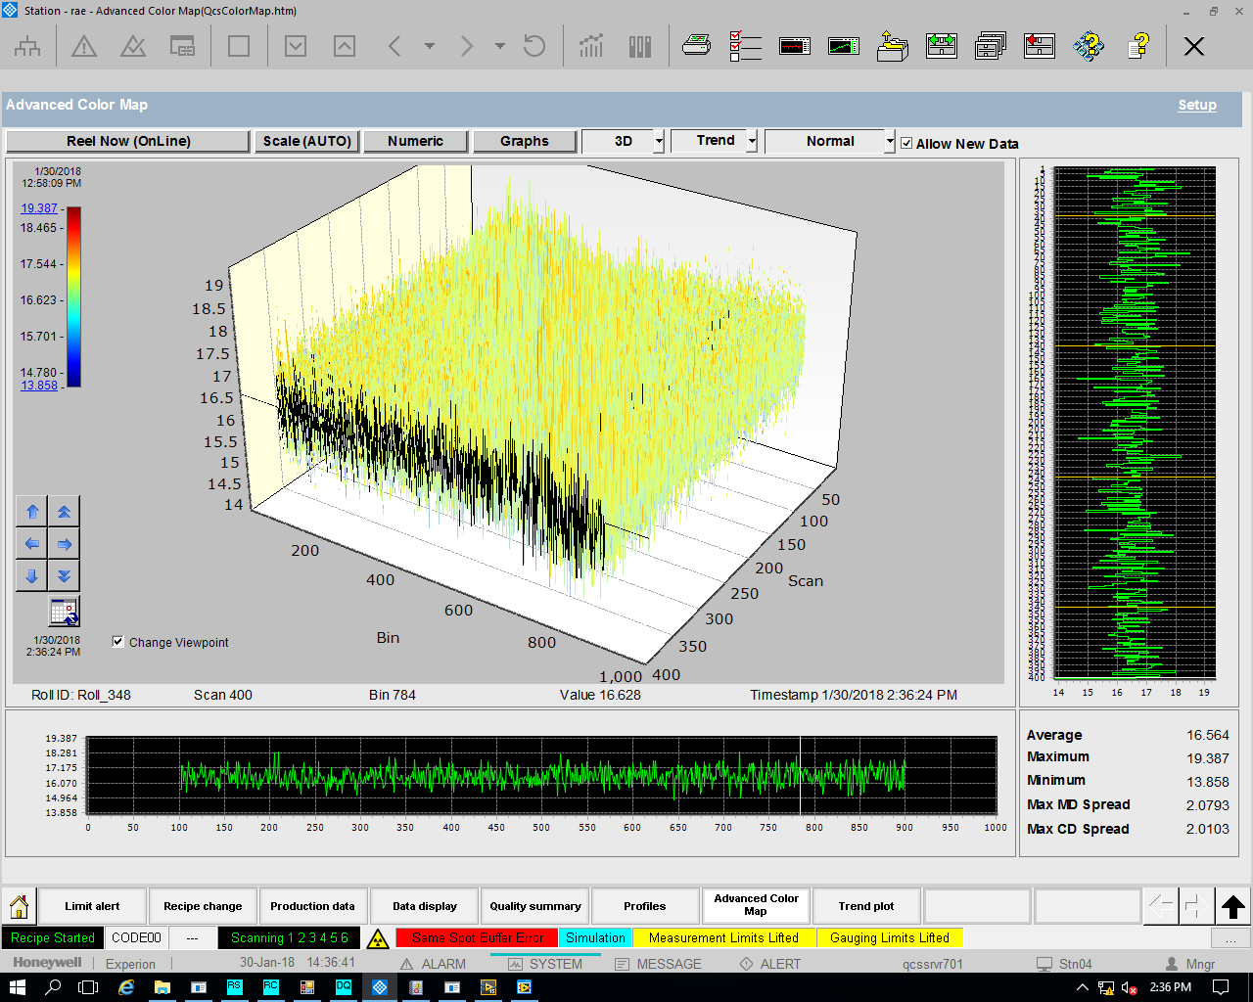
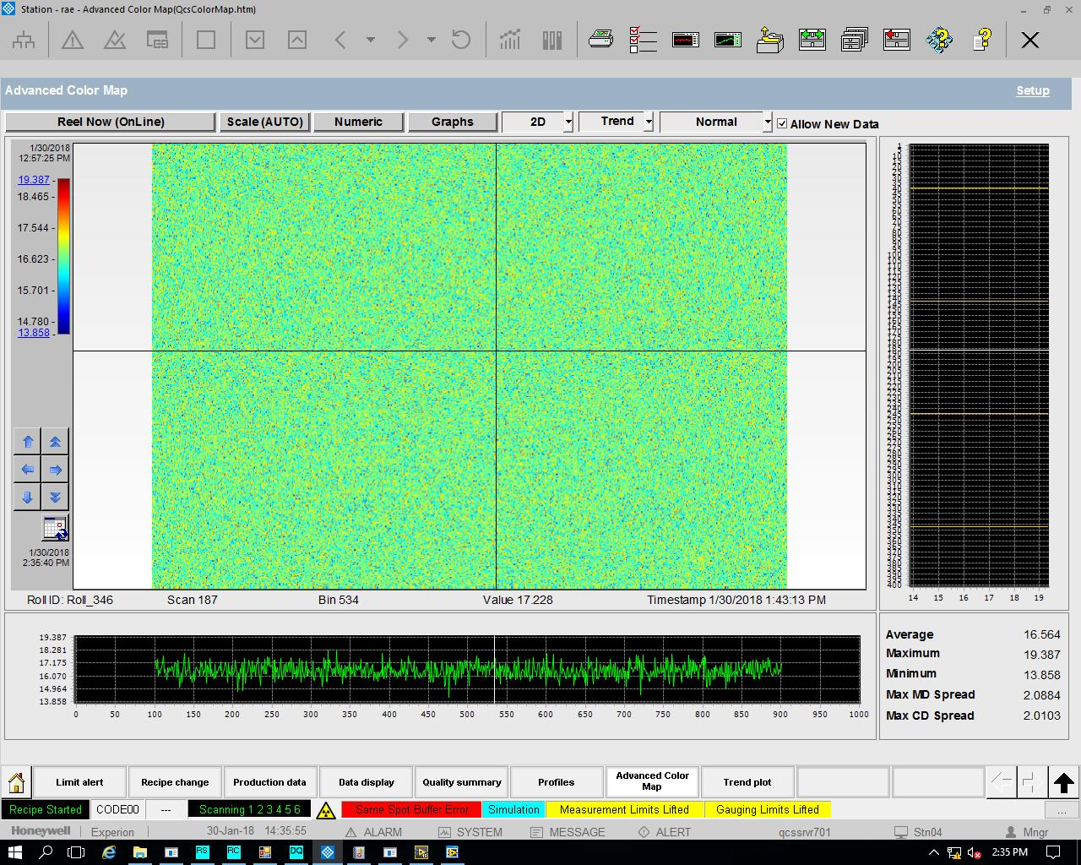
Historical Data Analysis: 2D & 3D Color Map
Enhanced to display up to 400 Scans Data at a time. Storage of profiles for 1 year.

Slide 23
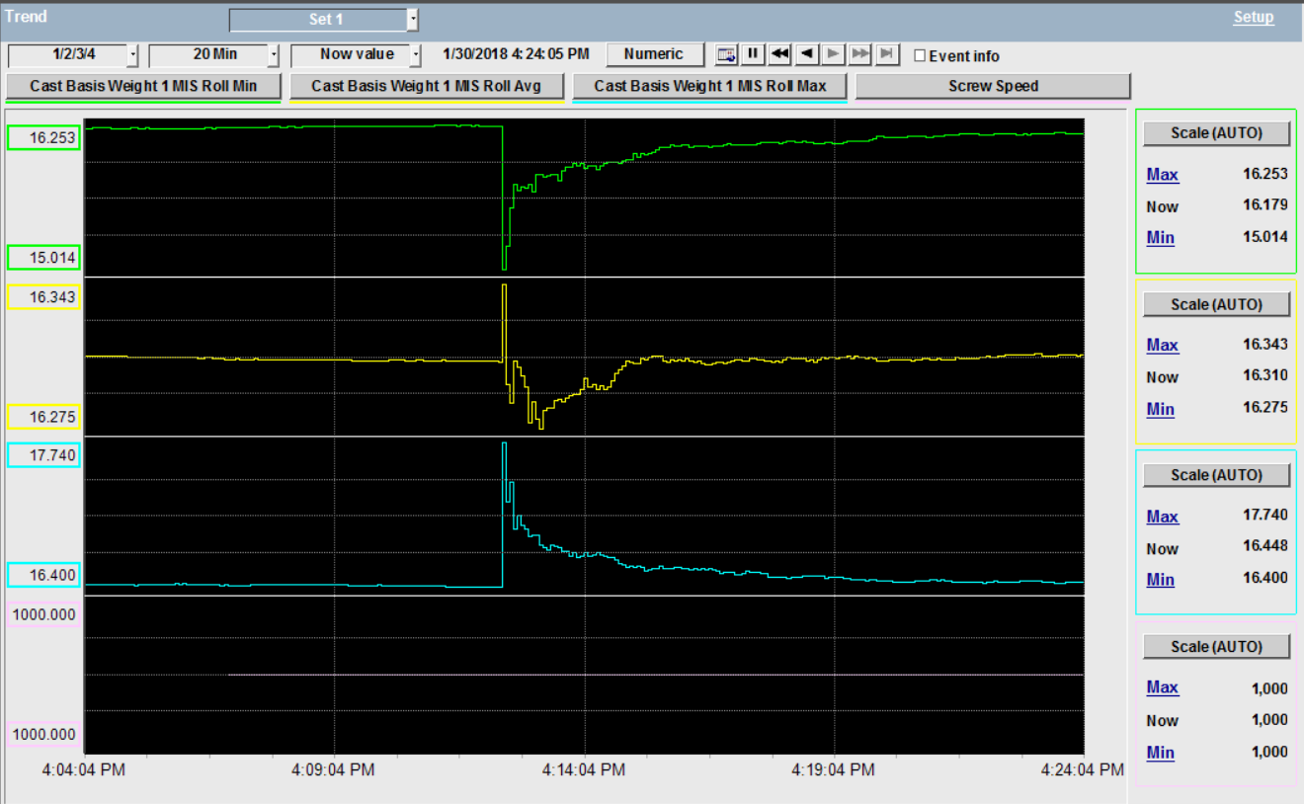
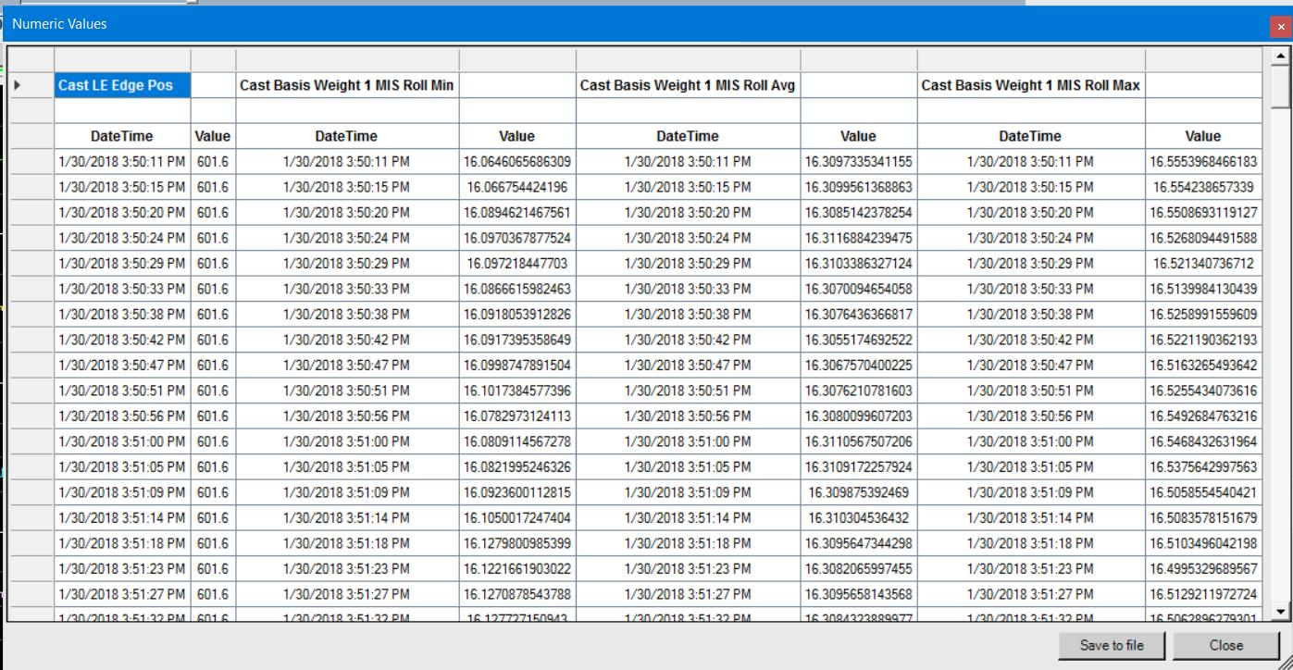
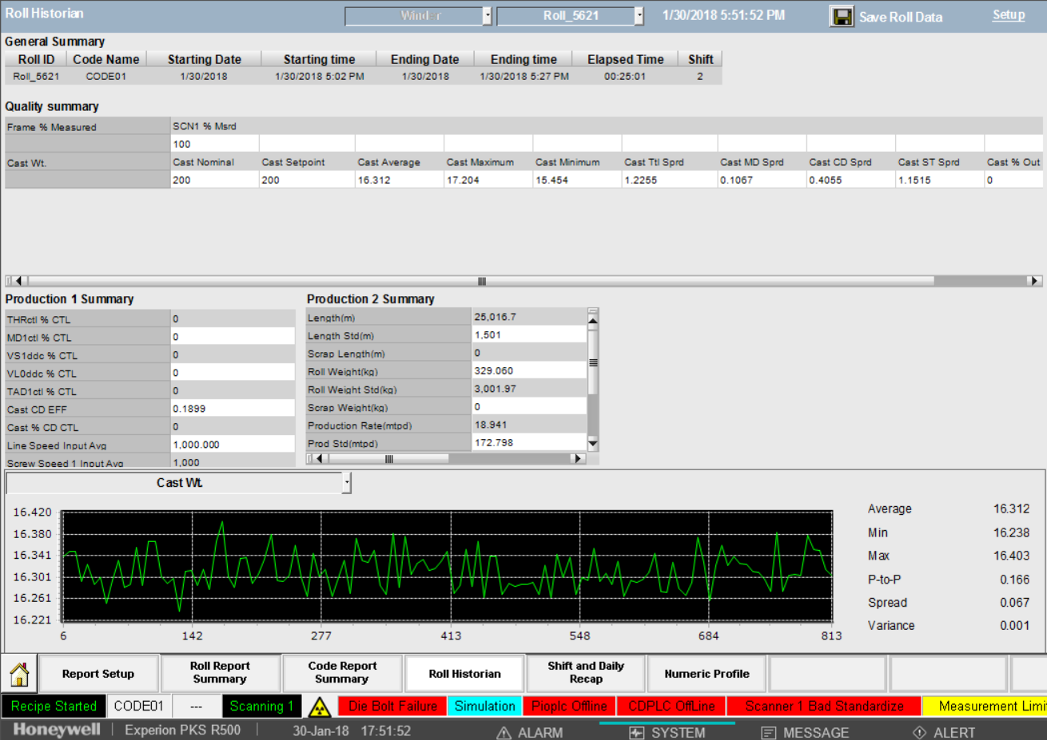
Integrated Quality History: Trend, MIS, Export Data
Trend Control will show directly the historical data up to last one year.
In MIS one can select one year old Roll for viewing the report.
Export the tag data for offline analysis.

Slide 24
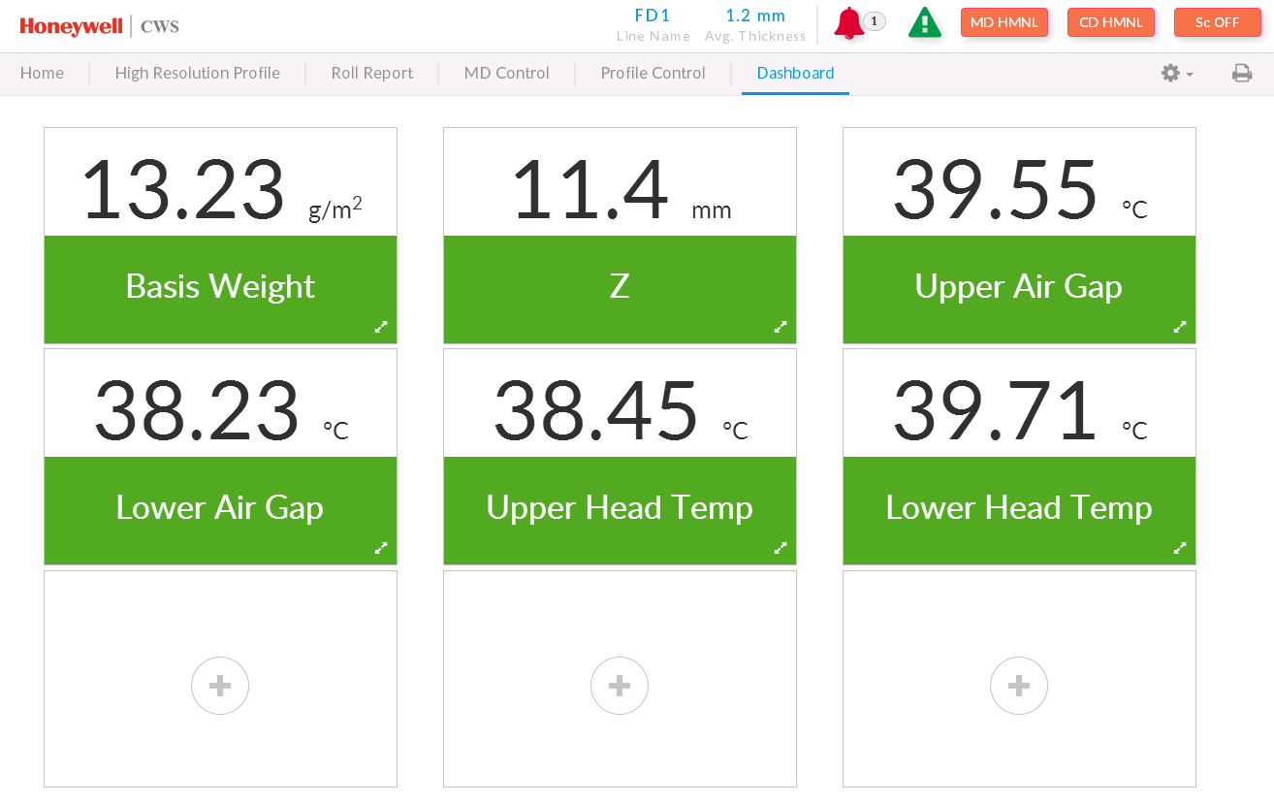
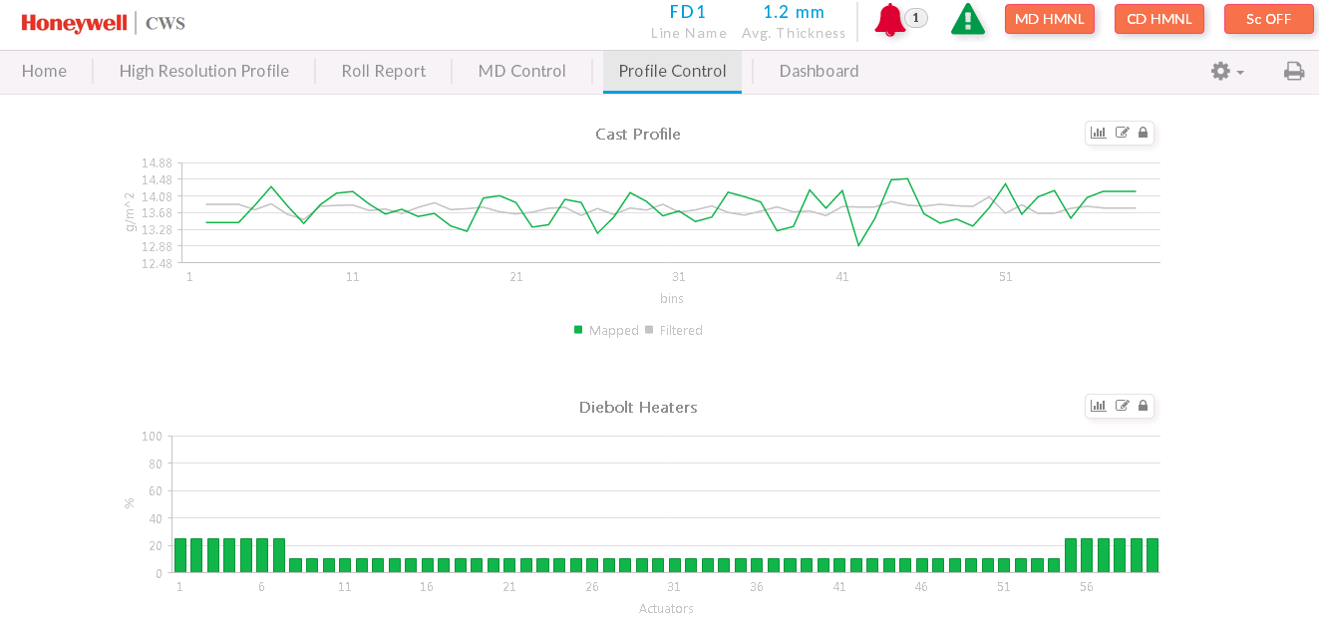
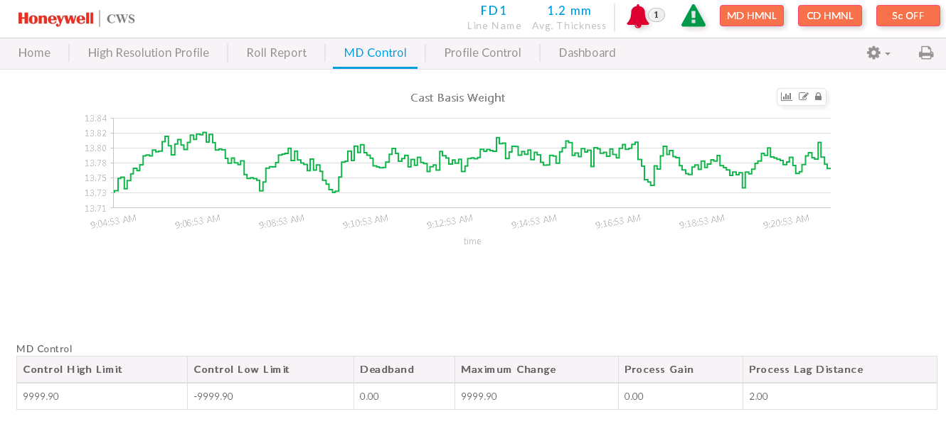
Browser based displays for QCS
Access displays from Web Browser – IE, Chrome, Safari
HTML5 Technology, for Tablet & Touch screen based operation or normal PC Station
Available for Single Scanner, Single-Dual Sensor Templates
Casual access to QCS displays from mill LAN with zero client installation
No additional loading in QCS server for up to 20 web clients
Notes:
Dashboard – Important measurement parameters to be viewed from a distance all the time. (9)
Profile Control – Thickness profile mapped and filtered chart and diebolt opening in percentage (8)
MD Control – Cast basis weight trend and MD control parameters (7)

Slide 25




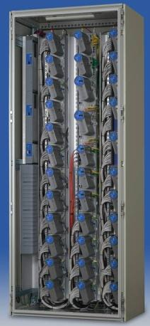





Virtualization to Minimize Lifecycle IT costs
Central Virtual Machines Management
Manage
OWS and Servers on Virtual PC
OWS 1
OWS 3
DCS 1
<spare>
OWS 2
QCS 2
<spare>
<spare>
QCS 1
DCS2
<spare>
<spare>
Virtualization OS
VMware ESXi
VMware ESXi
VMware ESXi
Virtualization Host
Virtual Infrastructure
QCS-DCS Network
Hypervisor
OWS 1
Networking
OWS 2
OWS 3
DCS Controller
Compute
Storage
80%+ Reduction in Maintenance, Space, Energy Use and Better Security

Slide 26
ALPHA MPC MD Multivariable Controls
Major changes
  Alpha MPC replaces Profit Controller
    Based on the model predictive control (MPC) technology developed for our multivariable CD controls
  Improved automatic grade change package (for both MDMV and traditional MD)
  Improved user interface utilizing Honeywell User Experience design principles
Benefits
  Multivariable MD control specifically designed for paper machine applications, based on 15+ years of MDMV experience
  Demonstrated improvements in control performance, specifically for applications which were problematic for Profit
  Improved grade change performance
  Simplified configuration and tuning
  Simplified user interface for operators
  Reduced cost to deploy and maintain

Slide 27


Performance Results: Setpoint Change
Profit Setpoint Change
Alpha MPC Setpoint Change
43% Less Error From Expected Trajectory

Slide 28


Performance Results: Coordinated Speed Ramp
27
Alpha MPC: Up to 15 fpm/min
(150% improvement)
Profit: Limited to 6 fpm/min

Slide 29

Simplified Configurable MD Control Summary
28

Slide 30


Improved Bump Test and Model Identification Displays
29

Slide 31

Simplified Process Model Display
30

Slide 32


Closing the Loop to Control MD Crepe Quality
Multivariable model using Crepe Macro/Micro and Caliper as the controlled variables (CVs)
Manipulated variables:
  Blade Loading pressure kN/m
  Crepe adhesive & coating dosing %
  Wet strength & Surfactants %
  Sheet moisture
  Refining
  Crepe ratio
Disturbance variables
  pH
  Basis weight
  Blade angle 12-24 deg
  Sheet take off angle 52-68 deg
  Sheet to blade angle 12-30 deg (90-grind angle)
  Dryer & Blade age
  Stock blending mix
Past
Future
Optimal Response
Predicted
Setpoint
Predicted
Unforced
CV
Unforced
Response
Response
Control Funnel
CV₁
Profit Controller
MV₁
MV
Assumed Values
CV₂
.
.
MV₂
.
.
.
.
CV_{n}
MV_{m}
Minimum Effort Move
.
T=0
.
.
DV₁
DV₂
DV_{l}

Slide 33

TISSUE MACHINE – Energy & GRADE CHANGE Optimization
Energy cost savings of $1.30/ton
Annual production increased by 135 tons

Slide 34
MULTIVARIABLE CD CONTROLs
Actual and Modeled AutoSlice Response in Dry Weight Profile
4
108
2
54
[gsm]
Actuator
Setpoints
0
0
-2
-54
-4
-108
Actual and Modeled AutoSlice Response in Moisture Profile
4
108
2
54
Actuator
Setpoints
[%moisture]
0
0
-2
-54
-4
-108
Actual and Modeled AutoSlice Response in Caliper Profile
5
108
54
Actuator
Setpoints
[microns]
0
0
-54
-5
0
1000
2000
3000
4000
5000
6000
7000
-108
CD Position, [mm]

Slide 35

TRADITIONAL CD CONTROLS
Scenario
Switching
Scanner
Measurement
Measurement
Processing
CD
Controllers
Actuator
Management
CD Actuator
Link Interface
ALIGNMENT
HiRes Profiles
LowRes Profiles

Slide 36

Performance CDMultivariable
Measurement
Processing
Process
Predictions
Multivariable
CD Optimization
Actuator
Management
IntelliMap
Process Model
Tuning Parameters

Slide 37
Process Predictions
Performance CDMultivariable calculates optimal setpoints for every scan to minimize future predicted profile variation
Areas to be minimized by optimization
Predicted measurement profiles are calculated over the control horizon
CD Measurements
Property
Measurement
Prediction Horizon
Time (Scans)
Predicted Measurement
Future Target Profiles

Slide 38
PCDMV - Benefits
Multi Scanner Support
  Newsprint Example with ExPress scanner
  Easily switch between scanners
10 min reduction in time to reach sellable paper
$270K per year in additional profit
Significantly improved uniformity of moisture profile going into the dryer section
  Improved runnability
  Less tension rejects
  Less shrinkage reject
  Can translate to lots of $$$
Paper threaded after
sheet break

Slide 39





Quality Optimizer: On Premise Quality Management Solution
Quality measurements
Defects
Traceability
Collect data in real time: QCS, DCS, Lab
Fibre, chemicals, water, steam, gas, electric
Consumables (blades, felts, cores, etc)
Down-time, transfers, sheet-breaks
Standard cost data
Thin client (HTML5) visualisation
Enabling Digital Transformation Today

Slide 40


Honeywell Connected Plant: QCS 4.0 Cloud Based Solution
Available
on any device, anywhere, zero installation and maintenance
https://qcs.demo.dev.connectedplant.honeywell.com/
OPTIMIZE QCS PERFORMANCE, ANYTIME & ANYWHERE
Notes:
Demo: https://qcs.demo.dev.connectedplant.honeywell.com/
User: smartline
Pwd: avt
Use chrome for best results

Slide 41
Summary – Why Choose Honeywell
Most experience of any supplier in global Tissue automation with more than 300 systems installed worldwide with multi-national tissue companies as well as national producers
Leading supplier to tissue machinery OEM companies
Fully integrate broad portfolio of latest measurement and control technology for complete process optimization from headbox to reel, giving tangible long term business results
QCS4.0 integration for total quality information, service and 24x7 support anytime, anywhere
Proven track record of project delivery for on time startup and on control from the very first reel
Local service and support capability for long term reduced cost of ownership and sustained benefits
Honeywell is your partner to achieve your long term business objectives

Slide 42
Q&A
Any questions?

